Slide 1
IMDB Movie Analysis
By- Rahul M Ramchandani

Slide 2
Project Description
We are given a dataset which is related to IMDB Movies. The problem to investigate is that: "What factors influence the success of a movie on IMDB?"
The impact of this problem is significant for movie producers, directors, and investors who want to understand what makes a movie successful to make informed decisions in their future projects. The project is about finding out valuable insights that can help to make informed decisions.

Slide 3
Tasks
SQL Tasks to be performed –
Movie Genre Analysis
Movie Duration Analysis
Language Analysis
Director Analysis
Budget Analysis
Software used :-
Microsoft Excel 2021

Slide 4
Approach
To achieve our project goals, we'll start by downloading and familiarizing ourselves with the dataset. Once we have the data, we'll clean it up by removing any null values and deleting unnecessary columns.
Then after data cleaning, we'll dive into the data analysis using Excel. This will involve manipulating the data to extract key information, calculating various statistics, and visualizing relationships between different variables. We'll use Excel functions and charts to find the answers we need.
Finally, based on our analysis, we will create comprehensive reports to present our findings and insights.

Slide 5
Movie Genre Analysis
Task : Determine the most common genres of movies in the dataset. Then, for each genre, calculate descriptive statistics (mean, median, mode, range, variance, standard deviation) of the IMDB scores.
First step involves cleaning the data.
Columns like color, director_facebook_likes, actor_3_facebook_likes, actor_2_name, actor_1_facebook_likes, cast_total_facebook_likes, actor_3_name, facenumber_in_poster, plot_keywords, movie_imdb_link, content_rating, actor_2_facebook_likes, aspect_ratio, movie_facebook_likes are irrelevant data. It needs to be dropped.
Now we need to remove the rows which contains null values. Then we need to remove duplicates from dataset.
We will then we will separate multiple genres and use COUNTIF function to count the number of movies for each genre.
Then we will use Excel's functions like AVERAGE, MEDIAN, MODE, MAX, MIN, VAR, and STDEV to calculate descriptive statistics.

Slide 6
Movie Genre Analysis
Formulas used-
Count : =COUNTIF($A$2:$A$3849, A2)
Mean : =AVERAGEIF(IMDB_Movies_Cleaned!$E$2:$E$3849, A2, IMDB_Movies_Cleaned!$N$2:$N$3849)
Median: =MEDIAN(IF(IMDB_Movies_Cleaned!$E$2:$E$3849=A2, IMDB_Movies_Cleaned!$N$2:$N$3849))
Mode: =MODE.SNGL(IF(IMDB_Movies_Cleaned!$E$2:$E$3849=A2, IMDB_Movies_Cleaned!$N$2:$N$3849))
Max: =MAX(IF(IMDB_Movies_Cleaned!$E$2:$E$3849=A2, IMDB_Movies_Cleaned!$N$2:$N$3849))
Min: =MIN(IF(IMDB_Movies_Cleaned!$E$2:$E$3849=A2, IMDB_Movies_Cleaned!$N$2:$N$3849))
Variance: =VAR.S(IF(IMDB_Movies_Cleaned!$E$2:$E$3849=A2, IMDB_Movies_Cleaned!$N$2:$N$3849))
Standard Deviation: =STDEV.S(IF(IMDB_Movies_Cleaned!$E$2:$E$3849=A2, IMDB_Movies_Cleaned!$N$2:$N$3849))

Slide 7
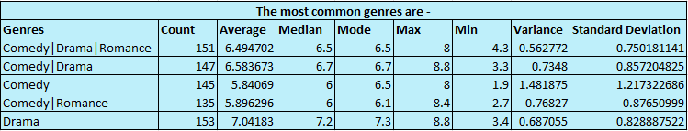
Movie Genre Analysis
Result -

Slide 8
Movie Duration Analysis
Task : Analyze the distribution of movie durations and identify the relationship between movie duration and IMDB score.
First we will select columns- duration and imdb_score.
Then we will use Excel's functions like AVERAGE, MEDIAN, and STDEV to calculate descriptive statistics.
Formulas to be used :-
Mean: =AVERAGE(A:A)
Median:=MEDIAN(A:A)
Standard deviation: =STDEV.S(A:A)

Slide 9
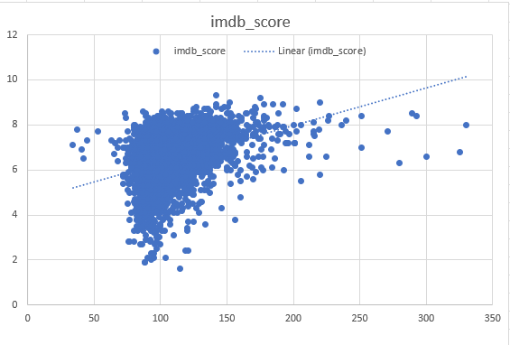

Movie Duration Analysis
Result -

Slide 10
Language Analysis
Task : Determine the most common languages used in movies and analyze their impact on the IMDB score using descriptive statistics.
First we will select these columns- language and imdb_score.
We will then use COUNTIF function to count the number of movies for each language.
Then we will calculate the Average, Median and standard deviation using the formulas below.
Formulas to be used :-
Count: =COUNTIFS(IMDB_Movies_Cleaned!$J$2:$J$3849,A2)
Mean: =AVERAGEIFS(IMDB_Movies_Cleaned!$N$2:$N$3849, IMDB_Movies_Cleaned!$J$2:$J$3849, A2)
Median: =MEDIAN(IF(IMDB_Movies_Cleaned!$J$2:$J$3849=A2, IMDB_Movies_Cleaned!$N$2:$N$3849))
Standard Deviation: =STDEV.S(IF(IMDB_Movies_Cleaned!$J$2:$J$3849=A2, IMDB_Movies_Cleaned!$N$2:$N$3849))

Slide 11
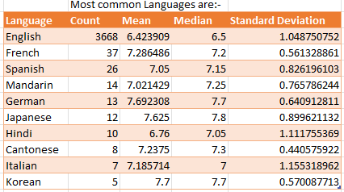
Language Analysis
Result -

Slide 12
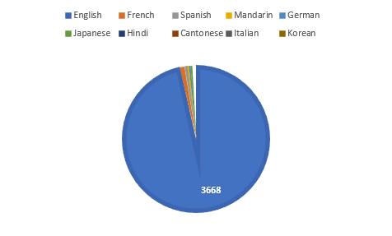
Language Analysis
Result -

Slide 13
Director Analysis
Task : Identify the top directors based on their average IMDB score and analyze their contribution to the success of movies using percentile calculations.
We will select column- director_name and imdb_score.
Then we will use AVERAGE function to Calculate the average IMDB score for each director.
Then we will calculate percentrank and use PERCENTILE function to identify the directors with the highest scores.
Formulas : -
Average : =AVERAGE(IF(IMDB_Movies_Cleaned!$A$2:$A$3849=A2,IMDB_Movies_Cleaned!$N$2:$N$3849))
Percentile : =PERCENTILE(J3:J11, J18)
PercentRank : =PERCENTRANK(J3:J12,8.6)

Slide 14
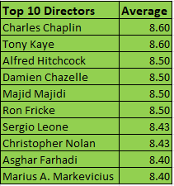

Director Analysis
Result -

Slide 15
Budget Analysis
Task : Analyze the correlation between movie budgets and gross earnings, and identify the movies with the highest profit margin.
First we will have to calculate profit margin for each movie by subtracting movie budget value from gross value.
Then, we will use CORREL function to calculate correlation coefficients between movie budgets and gross earnings.
Using MAX function we will get highest profit margin.
Formulas -
Correlation : =CORREL('[imdb movies cleaned]IMDB_Movies_Cleaned'!D:D, '[imdb movies cleaned]IMDB_Movies_Cleaned'!L:L)
Max: =Max(C:C)

Slide 16


Budget Analysis
Result -

Slide 17
Insights/Conclusion
Most Common Genre is Drama
Most Common Language is English
Top Directors are Charles Chaplin and Tony Kaye
Movies with Highest Profit Margin is Avatar
Google drive link for Excel sheet –
https://docs.google.com/spreadsheets/d/19EF9tsH8ExaAtYUOeem00qrjdQC5kvBd/edit?usp=drive_link&ouid=109013092337571372406&rtpof=true&sd=true

